Slide 1

Determining Topic Sentiment Across Social Network Platforms
Craig Dick

Slide 2
Introduction
Motivation around project
2.8 million subreddit communities Reddit in 2021, Twitter 206 million daily users
Misinformation is dangerous due to the health implications of COVID, can make the decision of a user getting the vaccine or not
What does the project aim to do?
Whether sentiment analysis can identify misinformation on social networks
Code to collect data, then analyse sentiment to see if this highlights misinformation

Slide 3
Background
Natural Language Processing
Pre-processing of data, NLP tasks, sentiment analysis
Collecting data on Twitter and Reddit
Streaming and REST API, Reddit and Pushshift API
Sentiment Analysis
VADER, Afinn, TextBlob, Naïve Bayes, BERT
Sentiment analysis with COVID
COVID brought new challenges, strong opinions on social media, label scales

Slide 4
Requirements
Functional
MH - System must be able to gather data off of Twitter and Reddit
MH - The posts must be saved to a database
MH - Search terms must be decided
MH - Display the results of Twitter vs Reddit
SH - Run the data collections for multiple weeks
SH - Compare different sentiment analysis libraries
SH - Analyse the sentiment in subreddits
CH - Trained BERT model on labelled data
WH – Website where user can search topic
Non-Functional
MH – Graphs must be easily understood
MH – Code should be commented
SH – Code modularised where possible
SH – The database should hold all of the data
SH – Libraries should be scalable
CH - The libraries should be optimised to get fast results
WH - The APIs should be able to be used at all times

Slide 5
Design
Programming Language needed
List of Search terms
Data collection on social media
Database storage
Sentiment analysis libraries
Layout of the design process to arrive at the end goal

Slide 6
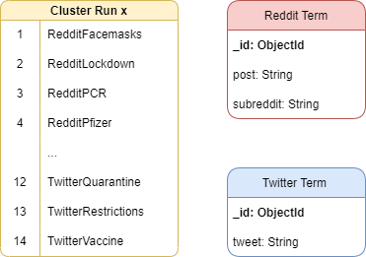
Implementation
Programming Language
Software Engineering Practices
Search Terms
Database Storage
Data collection APIs
Sentiment Analysis – Labels, Libraries, Saving Results
Graphs
MongoDB Schema to save the posts

Slide 7
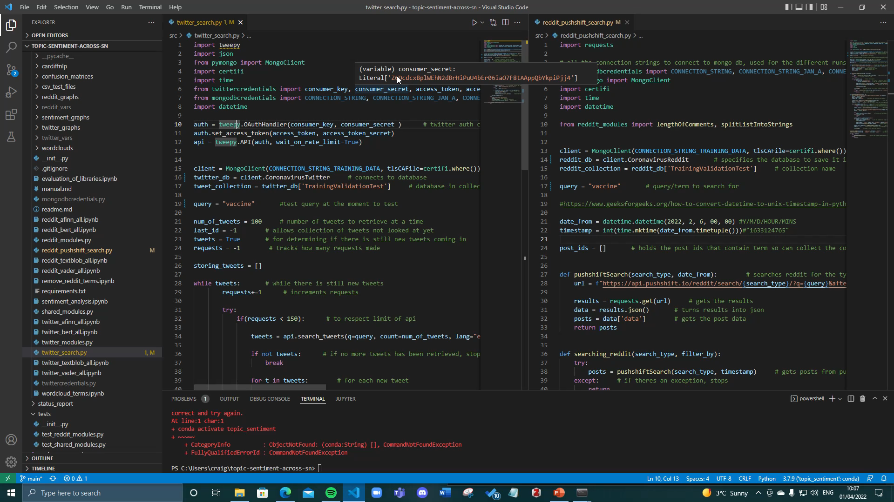
Demo of running Api’s

Slide 8
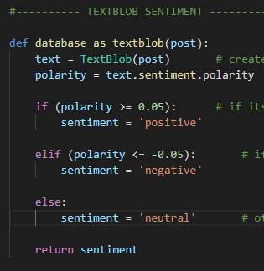
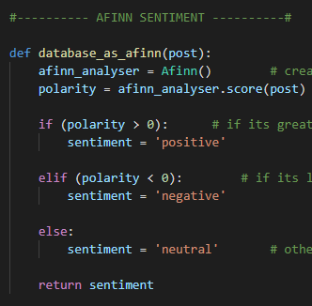
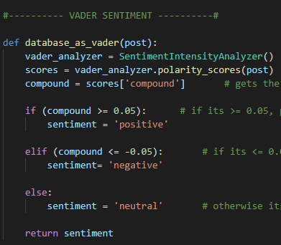
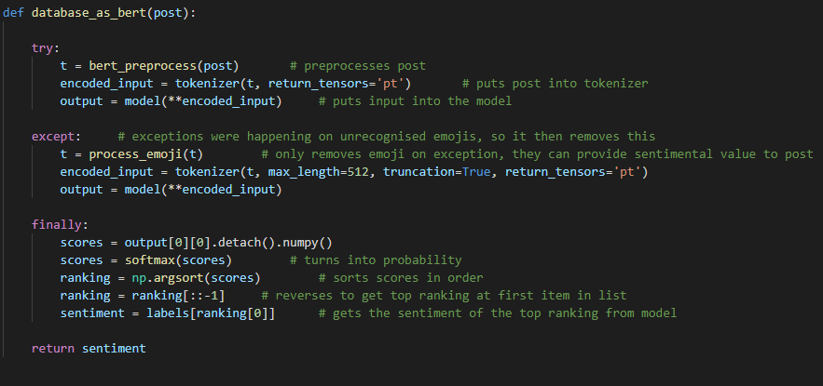
SENTIMENT ANALYSIS CODE

Slide 9
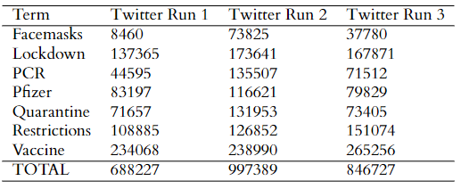
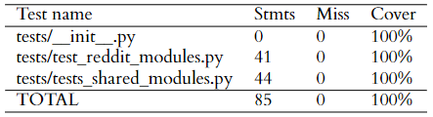
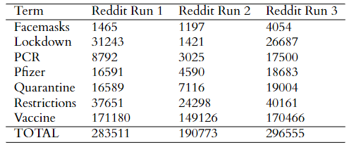
Evaluation - System
Feature testing with Pytest

Slide 10
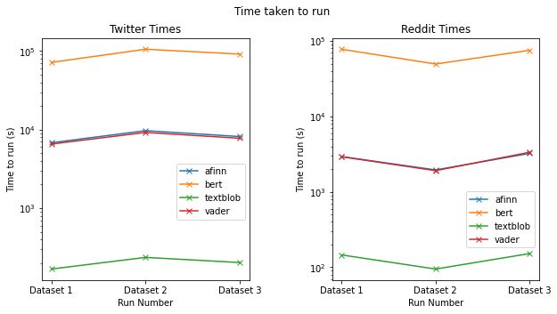
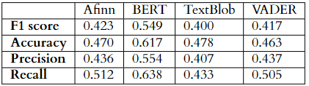
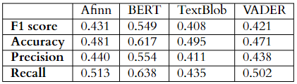
Evaluation - models

Slide 11
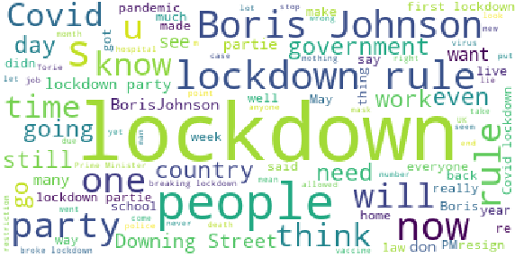
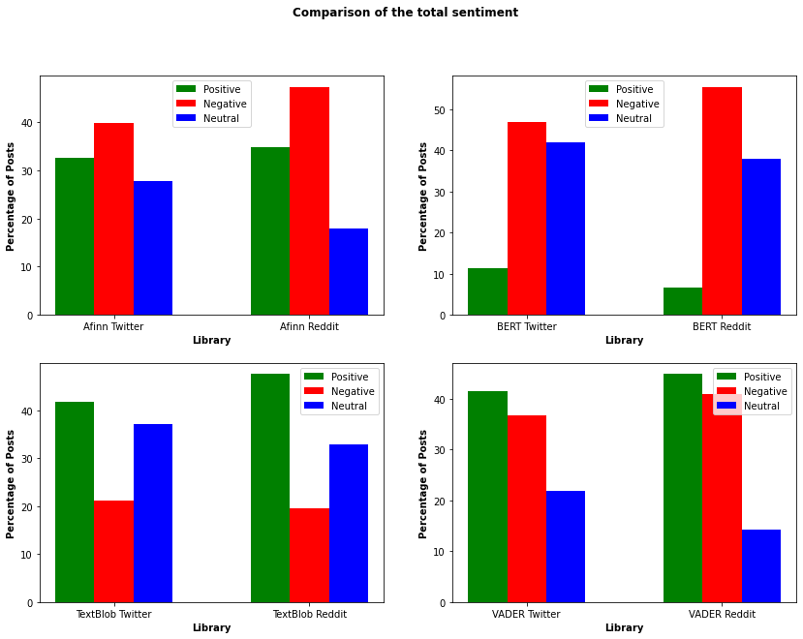
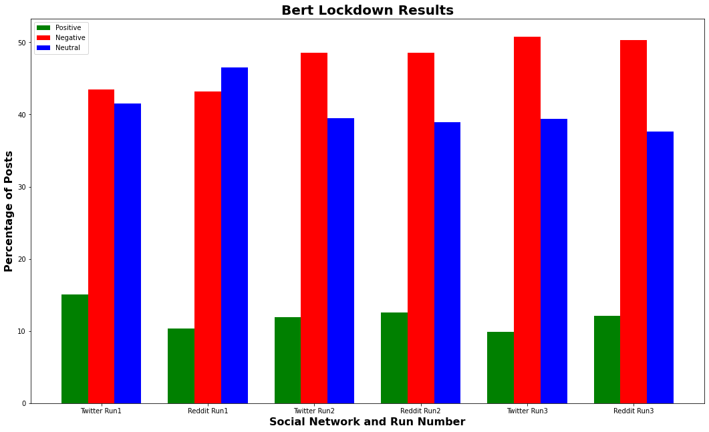
Evaluation – Sentiment analysis

Slide 12
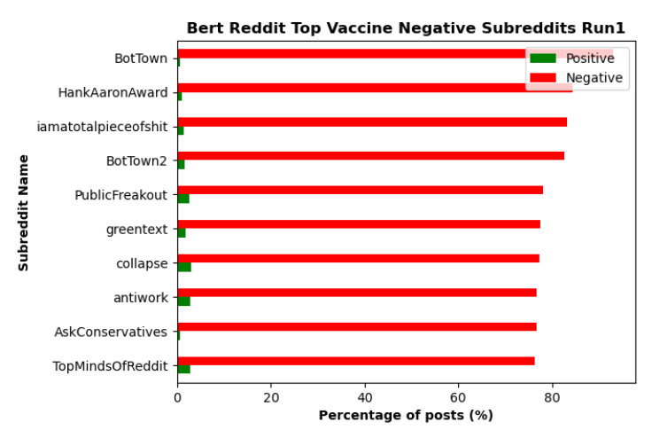
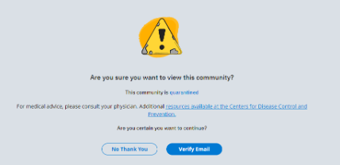
Evaluation – Subreddit Sentiment analysis

Slide 13
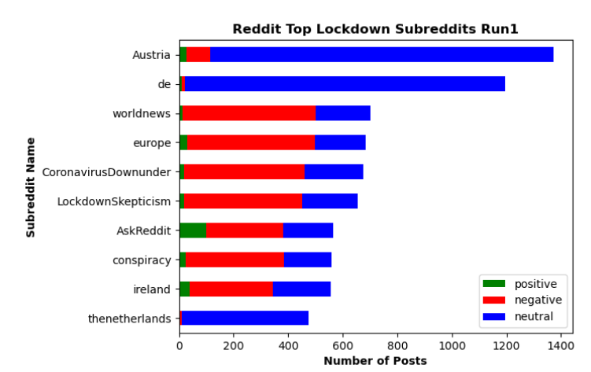
Evaluation – Subreddit Sentiment analysis

Slide 14
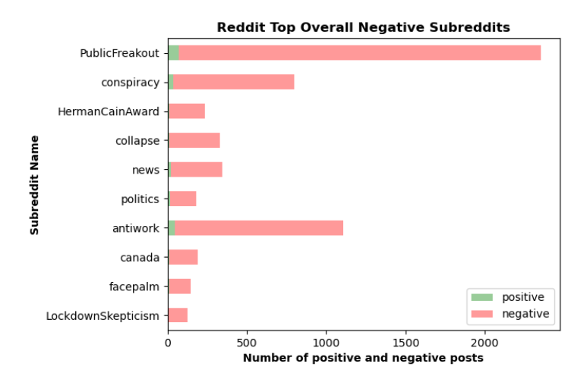
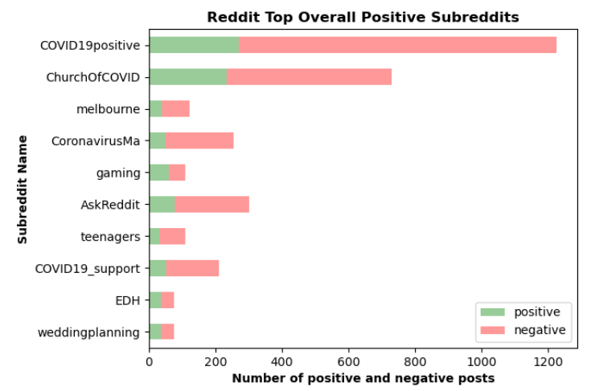
Evaluation – Subreddit Sentiment analysis

Slide 15


conclusion
Summary
Reflection and Limitations
Future work

